Slide 1



Bean Scopes with Annotations

Slide 2
Bean Scopes
Scope refers to the lifecycle of a bean
•
How long does the bean live?
•
How many instances are created?
•
How is the bean shared?
www.luv2code.com

Slide 3

Default Scope
Default scope is singleton
www.luv2code.com

Slide 4
Refresher: What Is a Singleton?
•
Spring Container creates only one instance of the bean, by default
•
It is cached in memory
•
All requests for the bean
•
will return a SHARED reference to the SAME bean
www.luv2code.com

Slide 5




What is a Singleton?
Spring
Coach theCoach = context.getBean("tennisCoach", Coach.class);
TennisCoach
...
Coach alphaCoach = context.getBean("tennisCoach", Coach.class);
www.luv2code.com

Slide 6

Explicitly Specify Bean Scope
@Component
@Scope("singleton")
public class TennisCoach implements Coach {
...
}
www.luv2code.com

Slide 7








Additional Spring Bean Scopes
Scope | Description
singleton | Create a single shared instance of the bean. Default scope.
prototype | Creates a new bean instance for each container request.
request | Scoped to an HTTP web request. Only used for web apps.
session | Scoped to an HTTP web session. Only used for web apps.
global-session | Scoped to a global HTTP web session. Only used for web apps.
www.luv2code.com

Slide 8
Prototype Scope Example
Prototype scope: new object for each request
@Component
@Scope("prototype")
public class TennisCoach implements Coach {
...
}
www.luv2code.com

Slide 9
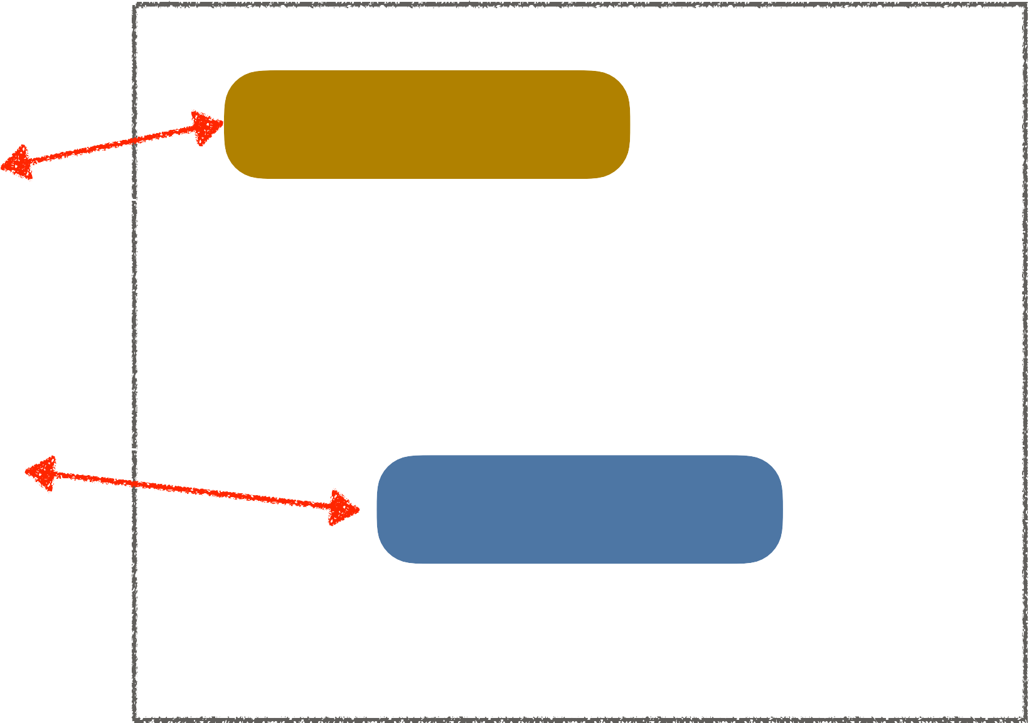
Prototype Scope Example
Prototype scope: new object for each request
Spring
Coach theCoach = context.getBean("tennisCoach", Coach.class);
TennisCoach
...
Coach alphaCoach = context.getBean("tennisCoach", Coach.class);
TennisCoach
www.luv2code.com

Slide 10
Bean Lifecycle Methods - Annotations

Slide 11

Bean Lifecycle
Container Started
Bean Instantiated
Dependencies Injected
Internal Spring Processing
Your Custom Init Method
Bean Is Ready For Use
Container Is Shutdown
Your Custom Destroy Method
www.luv2code.com

Slide 12
Bean Lifecycle Methods / Hooks
You can add custom code during bean initialization
Calling custom business logic methods
Setting up handles to resources (db, sockets, file etc)
•
You can add custom code during bean destruction
Calling custom business logic method
Clean up handles to resources (db, sockets, files etc)
www.luv2code.com

Slide 13

Init: method configuration
@Component
public class TennisCoach implements Coach {
@PostConstruct
public void doMyStartupStuff() { … }
...
}
www.luv2code.com

Slide 14
Destroy: method configuration
@Component
public class TennisCoach implements Coach {
@PreDestroy
public void doMyCleanupStuff() { … }
...
}
www.luv2code.com

Slide 15
Development Process
Step-By-Step
Define your methods for init and destroy
Add annotations: @PostConstruct and @PreDestroy
www.luv2code.com

